Slide 1
SURVIVE THE QUARANTINE
A game developed by Robson Santos

Slide 2

WHERE I AM FROM?
I live in São Paulo, nearby Paulista avenue. I used to be a branch/sales manager and i decided to have a change in my career, pursuing something that would challenge me and at the same time, bring me a new horizon.
I love tech, even in my hobbies i’m always in contact with it, discovering new app’s, playing games, but also binge watching some new sci-fi tv serie.

Slide 3
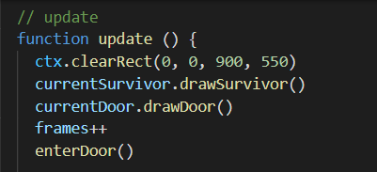
TECHNICAL
I don’t had a good understanding of both canvas and DOM manipulation during the classes, so i had to research and study all over again, while coding.
The most difficult challenge was to implement some mechanics that we didn't saw at the classes and labs.
I overcame those challenges with pure research and practice.

Slide 4

Pitch
My project is about an endless game, with the objective of use movimentation to escape as many rooms as you can, into a huge hotel infested with zombies.
The mechanics are quite simple, using the keyboard arrows to move left, right, up and down, until your character reach a door to a next level.
I choose this project because it’s challenging, will always be fresh (in every room, the positions are randomized) and mostly, would be a game that i would like to play!

Slide 5
BIG MISTAKE
I tried to implement to many complex functions before even testing the simple ones, which made me postpone the first tests in one day.
I learned how that everything is about testing. From the first line to the last.

Slide 6
DEMO
Link to demo. Have fun!

Slide 7
THANK YOU!
SURVIVE THE QUARANTINE - JS GAME
ROBSON SANTOS
IRONHACKER - WD FT - SP

